Slide 1
Artificial Intelligence Conference
O’Reilly + Intel AI (NYC)
Better Together Diversity Networking Lunch
17-Apr-2019
RESHAMA SHAIKH @reshamas

Slide 2
Building a welcoming and supportive community for women
@wimlds

Slide 3
THE MISSION
To support and promote women and gender minorities in machine learning & data science [& artificial intelligence]
Membership inclusive to any person / gender who supports our cause

Slide 4
About Me: RESHAMA SHAIKH
Statistician / Data Scientist
Organizer for New York WiMLDS chapter for past 4+ years
Board Member
WiMLDS
Big Apple Py (annual PyGotham Conference)
Teach Git workshops in NYC --> advance open source

Slide 5
ACKNOWLEDGMENT
To O’Reilly for their support of WiMLDS over the past 4 years
For their commitment to diversity
Community outreach to connect to women
Offering scholarships and travel stipends
Forefront of Code of Conduct implementation
Support of inclusion-focused nonprofits
Organizing a regular diversity luncheon

Slide 6
ABOUT WiMLDS
Founded December 2013
63 chapters in 27 countries
29 000+ members
Board: 4 members (US)
130+ organizers world-wide contribute to our community
Includes sponsors and our members
Includes our supporters on social media
ISC: involve organizers outside of US * in-progress *

Slide 7
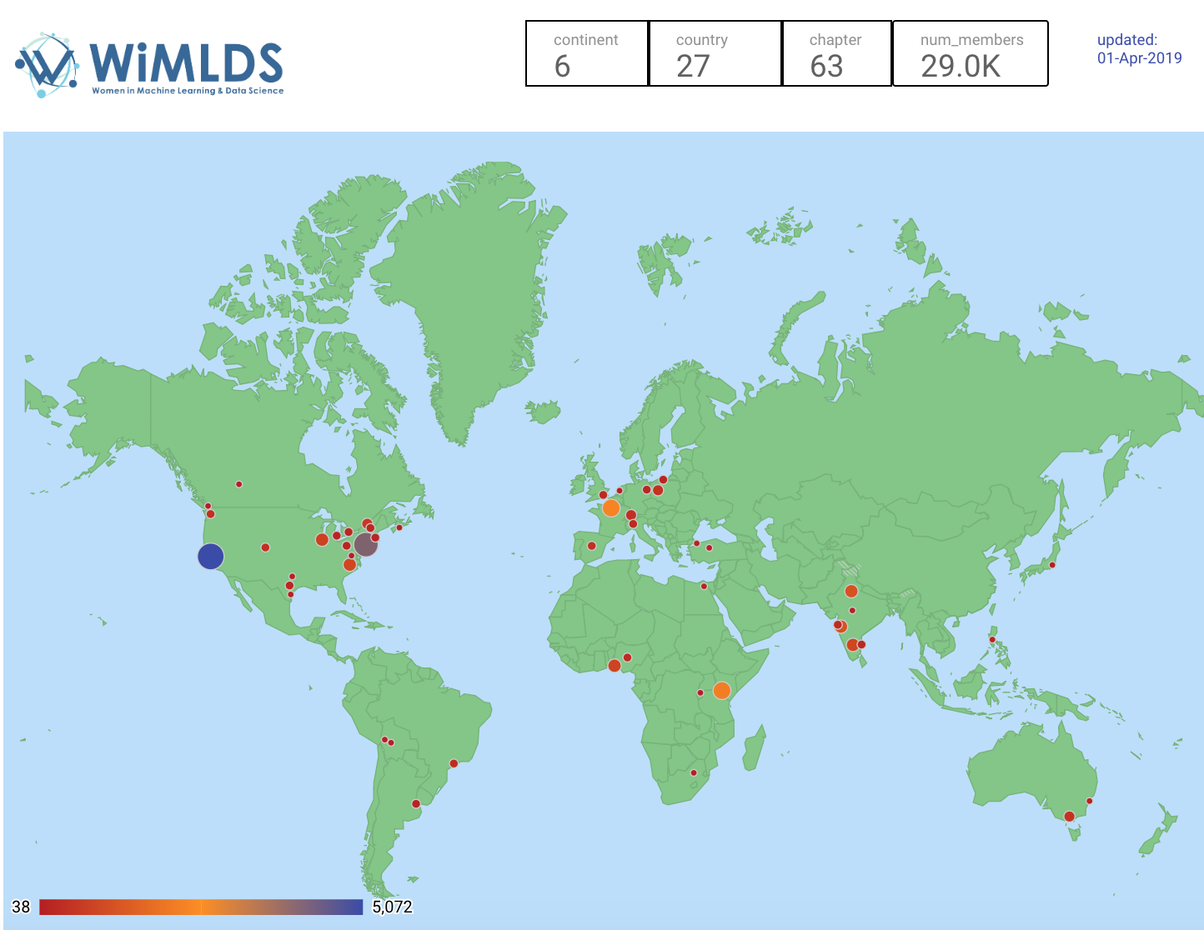

Slide 8
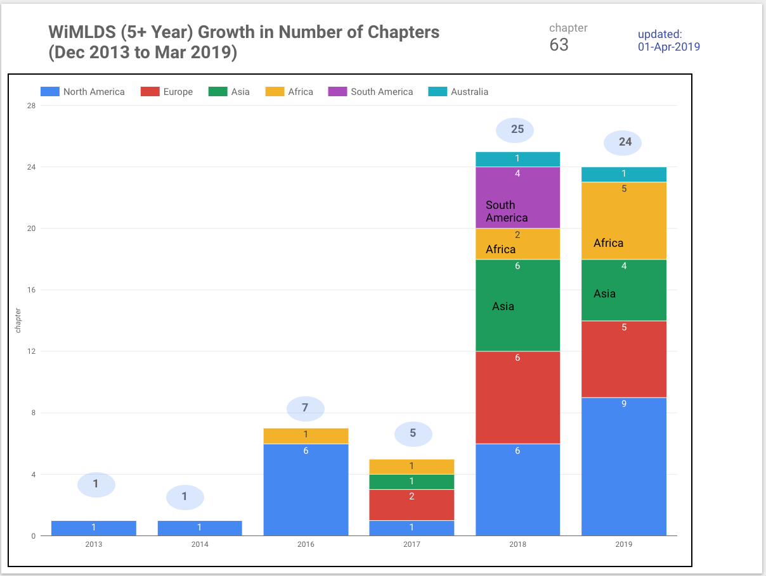

Slide 9
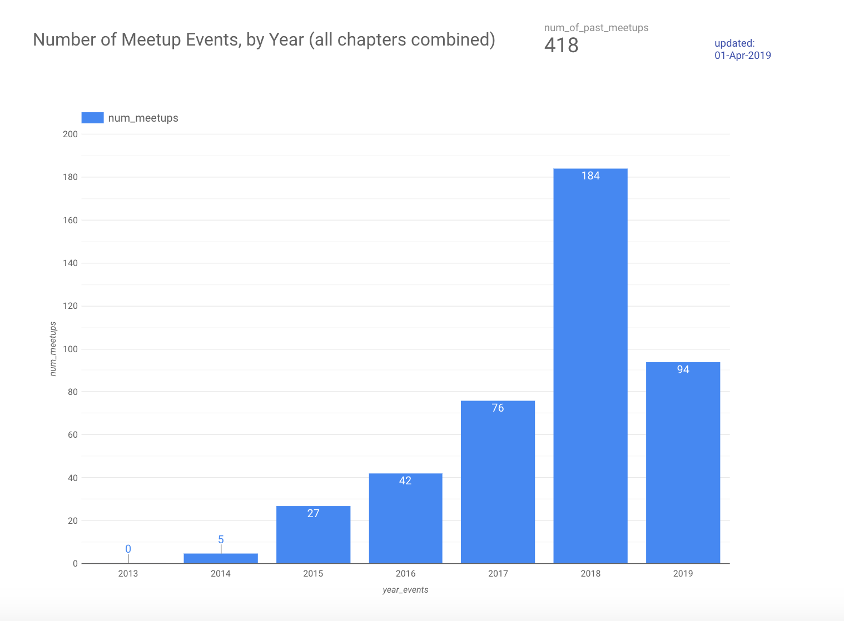

Slide 10
WHAT WE DO
Speaker events that feature women
Panel discussions require 50% women speakers
Events
Workshops: Python, R, TensorFlow, Probability
Open source sprints
Career Workshops
Code & Coffee
Hackathons
Job Board on our website

Slide 11
OPEN SOURCE INITIATIVE
Participation rates by women in open source are quite low (11%)
Even lower for Python (2%)
Lower still for the scikit-learn(a) library (0 to 1%)
(a) scikit-learn is the machine learning library for Python

Slide 12
Scikit-learn Open Source Sprints
All day Saturday event to work on “issues” on GitHub library
Events in NYC:
March 2017
September 2018
Expanding for 2019:
NYC: August
Nairobi, Kenya: June
San Francisco: November
We are looking for sponsors!

Slide 13
WHAT CAN BE DONE
If you hire or interview, consider that less women apply for positions, rewrite your job descriptions
If you manage, knowing women ask less often for raises and promotions, be an advocate for them
At my last job, a co-worker advocated for a pay adjustment
Let women speak
Amplify their voices at meeting

Slide 14
WHAT CAN BE DONE… more
Awareness of “manels”
Do not agree to be on a “manel”
Be aware
When men go out for a drink or play golf with other work colleagues, it is a disadvantage for women
Mentor and sponsor those from URGs
Code of Conduct, “walk the talk”
Create a space that is safe and welcoming for all

Slide 15
WHAT CAN BE DONE… more… more
Have the difficult conversations
Give feedback
Receive feedback
Crucial Conversations is a great book!

Slide 16
WHAT CAN BE DONE… data
Surveys
Please complete them → indicate gender. There’s a saying “we cannot understand what we cannot measure.” If we are not keeping statistics, then it is hard to implement and measure change

Slide 17
FINAL THOUGHTS
Don’t be afraid to ask, we all are figuring it out, including ourselves
“Women & non-binary” ---> “women & gender minority”
Code of Conduct implemented < 2 years ago
Example: Riyadh chapter
Pie will get bigger

Slide 18
CALL FOR ACTION
Sponsorship
Jobs can be posted on our Job Board
Follow us on social media
If your city doesn’t have a WiMLDS chapter, can begin one!
A Code of Conduct creates an inclusive and welcoming environment with accountability
We’re happy to answer any questions.

Slide 19
More Information
WiMLDS 2019 Q1 Report: https://reshamas.github.io/wimlds-2019-q1-report/
Code of Conduct article: https://reshamas.github.io/code-of-conduct-for-nips-and-other-stem-associations/

Slide 20
Connect with WiMLDS
Twitter: @wimlds
Website: wimlds.org
Email: info@wimlds.org

Slide 21
Connect with me
Twitter: @reshamas
Website: https://reshamas.github.io
Email: reshama@wimlds.org

